Slide 1
FWD Project
TOGAF 9 - Core Diagrams Project Context Diagram Phase E – Opportunities and Solutions

Slide 2
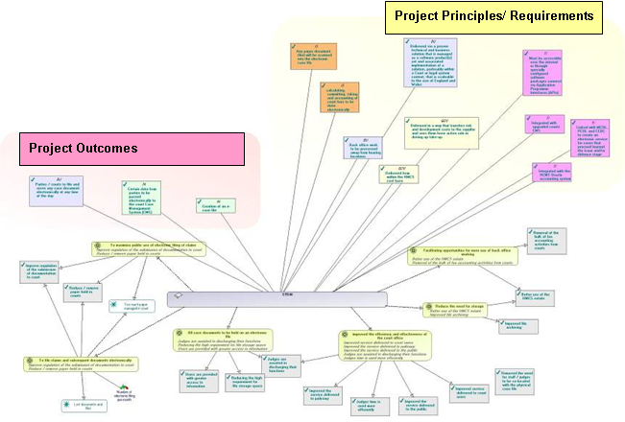
Project Context Diagram

Slide 3
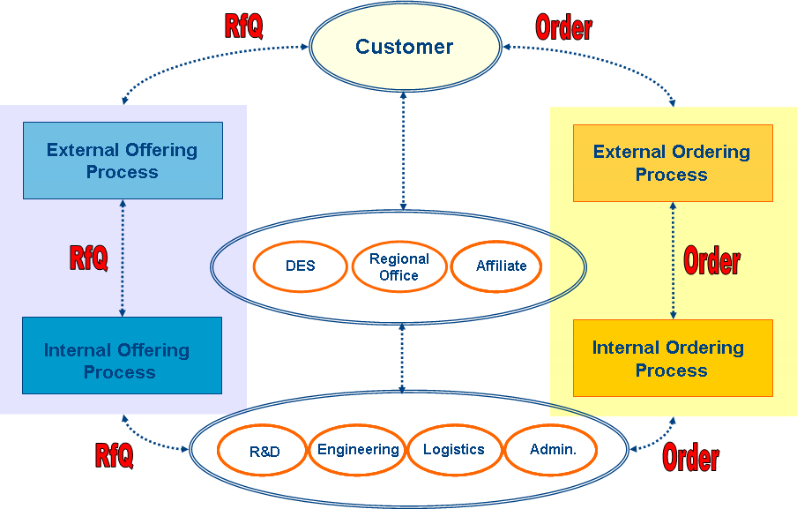
Project Context Diagram

Slide 4
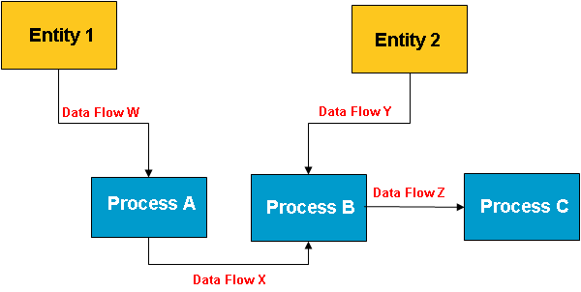
Project Context Diagram

